Slide 1
Basic Electrical Circuit
Robotics Club 360
Aditya Kesari

Slide 2
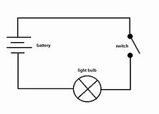
What is a circuit?
A complete and closed path for electricity to flow
A movement that starts and finishes at the same place

Slide 3
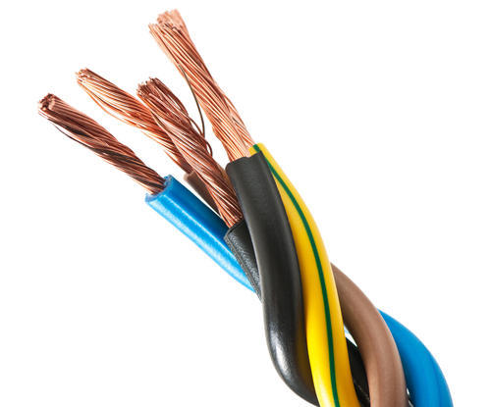
What is a conductor?
Something lets allows electricity to flow
Metal materials are usually good conductors
Examples: metals, water, humans

Slide 4
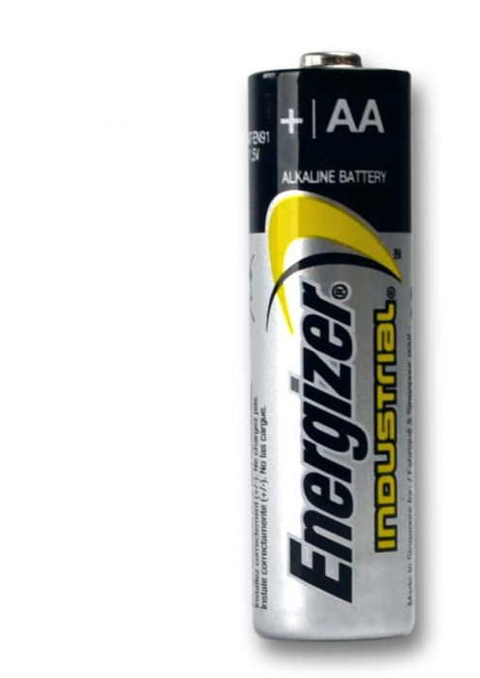
What is a battery?
+
A source of electrical power
Two poles: positive and negative
Converts chemical energy to electrical energy
-

Slide 5
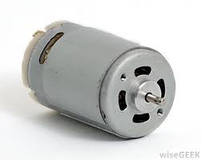
What is a motor?
Power for a vehicle or for some other device with moving parts
Converts electrical energy to kinetic energy

Slide 6
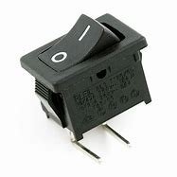
What is a switch?
A device for making and breaking the circuit
Starts and ends the system

